Slide 1
Circular Economy in Small Companies Within Amager
Karly Bigham, Brian Ferrarotti,
Andrew Gray, Jack Procaccini
Dorte Grastrup-Hansen
Project Sponsor
Miljøpunkt Amager
Karen Oates, Co-Advisor
Guillermo Salazar, Co-Advisor
Worcester Polytechnic Institute
Notes:
Juan

Slide 2
Linear Economy
Linear Economy
Disadvantages:
Products made with disposal in mind
Making new products requires resources
No resources recirculated
Raw materials
Production
Use
Non-recyclable waste
Notes:
Andy

Slide 3
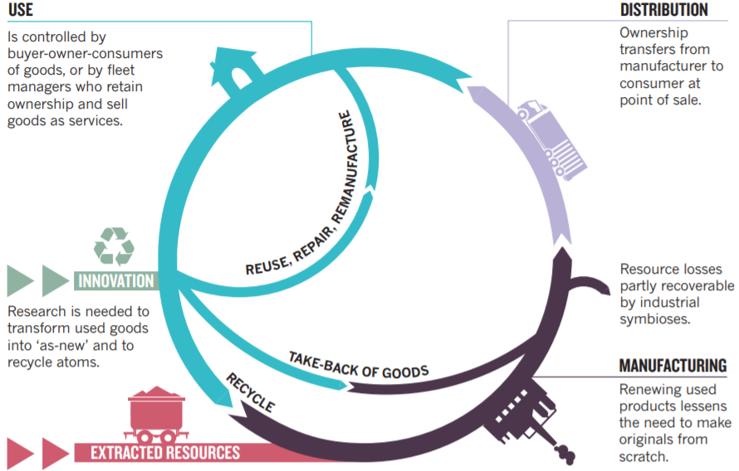
Circular Economy
Notes:
Drew

Slide 4
Mission Statement
This project aimed to assist Miljøpunkt Amager through the development of effective circular economy practices that could be implemented by small food companies in Amager in an effort to improve business sustainability.
Notes:
Jaque

Slide 5
Research Questions
What motivations do food businesses have to implementing strategies for a circular economy?
What are the challenges to implementing a circular economy within food businesses?
What information is necessary to assist food businesses in the implementation of circular economy practices?
Notes:
Andy

Slide 6
Importance and Benefits
Food Businesses
Miljøpunkt Amager
Local Citizens
Notes:
Karlita
Provide an understanding of sustainability in food businesses on the island of Amager
Assist sponsor with achieving one of their yearly initiatives to implement a ce economy
Help local citizens participate in a circular economy

Slide 7
Methods
Notes:
Juan

Slide 8
Case Studies
Components of Our Case Studies:
In-depth research of specific elements within a business
Analysis of resource flows for 2-3 products within businesses
Benefit:
Enables the application of theoretical circular economy concepts to real resource flows
Notes:
Jaque
In order to identify best practices for minimzing waste, we will be conduscting case studies. Since there are different interpretations of what a case study is, we will define a case study for our project as an in-depth analysis of a specific component of a business. More specifically, we will be analyzing the resource flows of 2-3 products within a business. The benefit of doing this,is it allows us to identify waste products at the source and then apply the theoretical concepts of a circular economy to each resource flow

Slide 9
Obtaining Case Study Criteria
Cost Savings
New Revenue Generation
Social
Resiliency
Professor Joseph Sarkis
Notes:
Karlita
Professor Joseph Sarkis from WPI. Talk about his many publications in circular economy, sustainability expert
Cost-savings: saving money by having sustainable practices
New Revenue Generation: making a new product from what would normally be waste and disposed of and gaining a new source of income through this
Social: having a green image and attracting more customers for having sustainable practices
Resiliency: having a local and reliable supplier and being able to control whether or not they use sustainable practices

Slide 10
Semi-Structured Interviews with Circular Economy Experts
Organizations and People we interviewed
TinkerTank
Michael Søgaard Jørgensen
Stine Hansen
Notes:
Drew

Slide 11
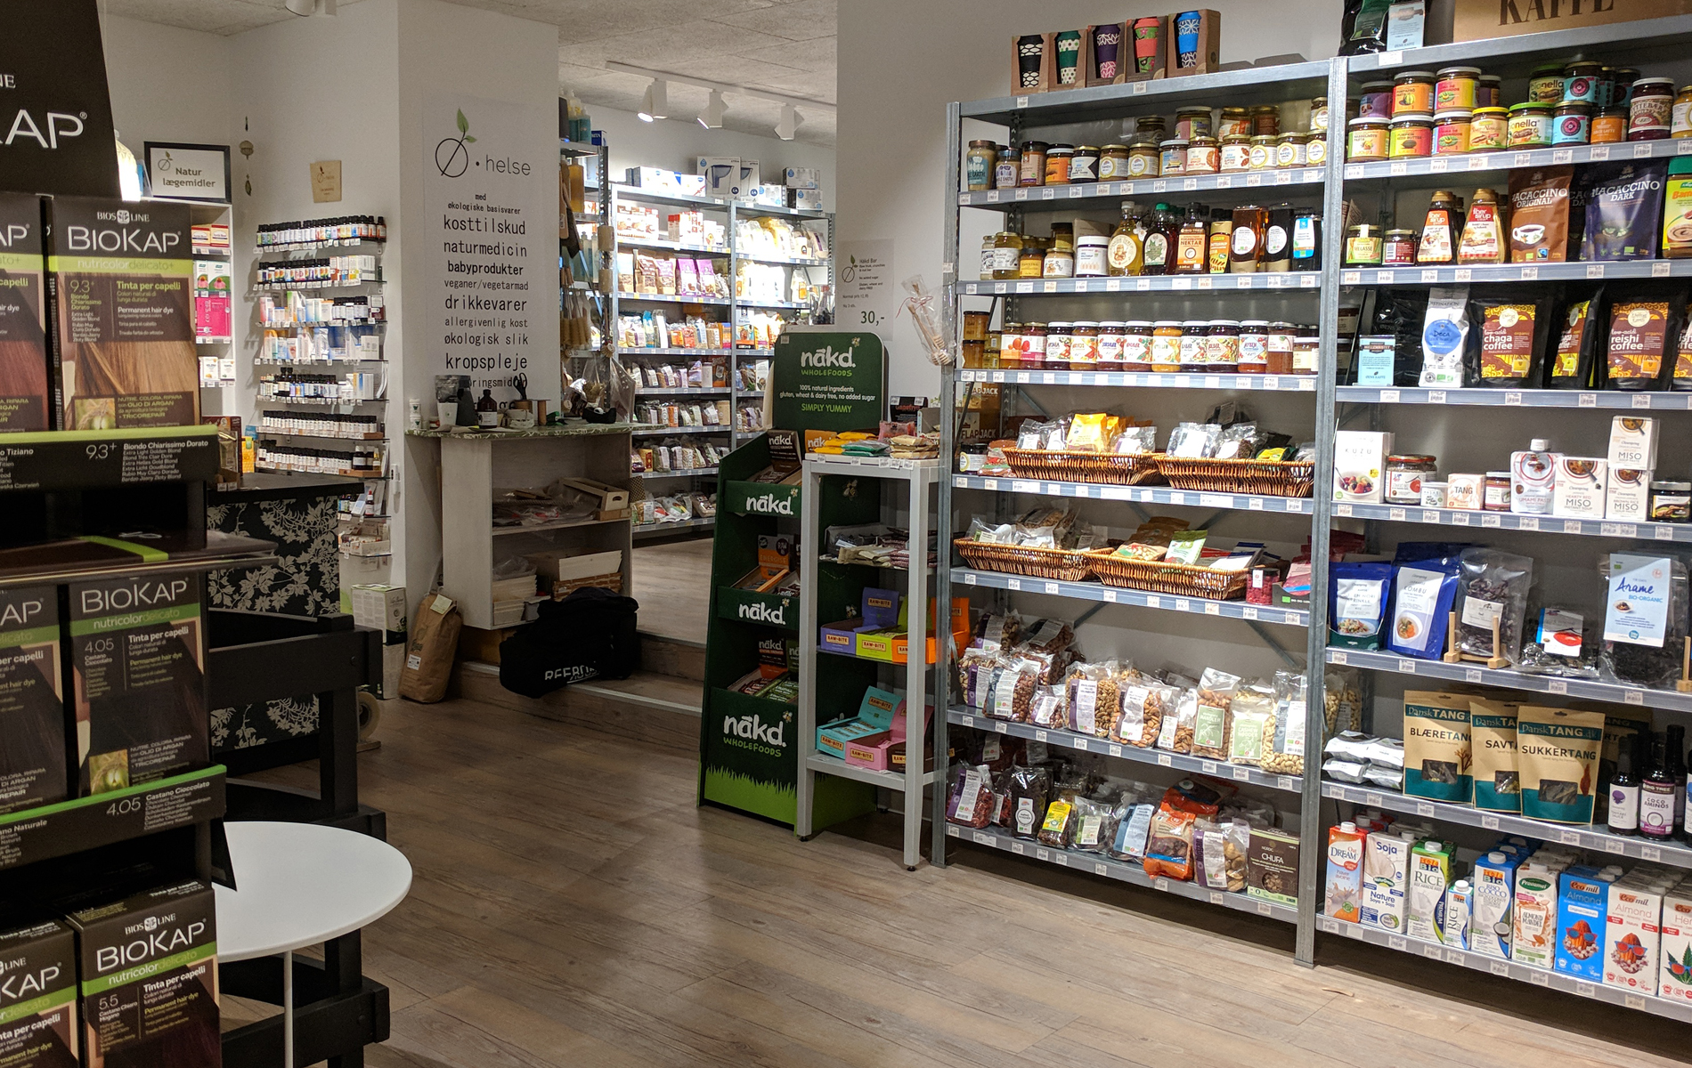
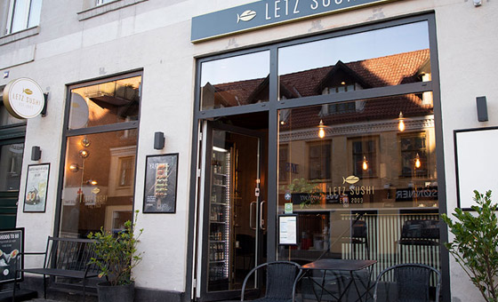
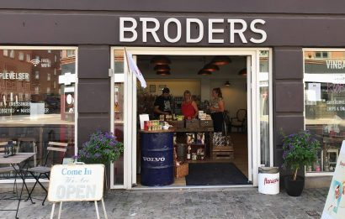
Business Selected for Case Studies
Letz
Sushi
Ø-helse
Il Buco
Broders
Notes:
Karl
O-helse: health foods
Il Buco: cafe
Letz Sushi: sushi restaurant
Broders: convenience store

Slide 12
Semi-Structured Interviews with Small Businesses
Gave insight to businesses’ opinions on circular economy
Circular economy/sustainability practices
Resource flows of 2-3 products per company
Notes:
Karlita
Suggest ways to reduce waste
As Andrew mentioned, both types of interviews aim to answer 3 of the objective research questions: what motivations, challenges and information is necessary in order to implement circular economy practices?
Interviews with the small businesses will give us insight as to how the actual businesses feel about implementing a circular economy
From these interviews, we aim to identify common trends of differences across the companies which will allow our sponsor, Miljopunkt Amager to offer circular economy solutions to a wider range of companies
We interviewed 1 individual from each company

Slide 13
Case Study Criteria Form for Businesses
Criteria | Definition | Example | Rank (0-100)
Cost-Savings | Identify ways to reduce material costs through the use of sustainable practices | Finding a business to take some/all of your waste for free instead of paying for the municipality to take it
New Revenue Generation | Any new source of revenue from a new sustainable product | A biodegradable bottle developed by a company generated a new stream of income
Social | Have a strong image as a green/sustainable business in order to attract customers | Advertising your green practices to attract new customers
Resiliency | The use of reliable, green and local suppliers instead of high-risk suppliers (the life cycle of your product is in your control) | Getting your eggs from the local organic farm instead of an international supplier
Notes:
Karlita
As we conduct all these interviews, we are going to be getting a lot of data; both qualitative and quantitative. As we obtain this information, we need to have some way to equally evaluate each company. This is where our case study criteria will come in. After speaking with sustainability expert Professor Sarkis, we have identified following five criteria to base our case studies on:
After speaking with Professor Sarkis, who has numerous publications regarding sustainability, we have identified the following criteria in order to conduct our case studies with. First we will look at cost savings. Cost savings include any reduction of cost as a result of implementing a circular economy. For example, reducing waste will reduce waste transportation costs. New revenue generation includes any new products that are created as a result of using a circular economy. Differentiation includes any green labels a company uses in order to identify their products. Resiliency is how well a company is able to maintain production of their product. For example, a company who receives resources from a supplier who has risky production practices, then the company will have a low rank for this criteria. Finally, legitimacy checks to see if the company’s values and goals are in line with the country’s goals as a whole.
During the interviews with these food businesses, we will also be asking them about how important these criteria are to their company. We will be asking each of them to rank the importance of the criteria from 0 to 100 with 0 being the least important and 100 being most important. For our third method of multi-criteria analysis, we will be using the criteria rankings provided by these businesses.

Slide 14
Multi-Criteria Analysis
1. Highlight Waste Products and CE Component(s) of Waste Management Methods
2. Identify Least Effective Waste Management Methods
Product Resource Flows
3. Use CE Expert Interviews to Determine Possible Solutions
4. Identify the Best CE Practice Using Criteria Rankings
Notes:
Brain
Greatest potential for improvement vs. least effective
Our final method is a multi-criteria analysis. To walk through this method, we first started with the product resource flows Karly just described. Second, in these flows, we identified the waste products in the flow and how they were being managed. These management methods were categorized based on what component of the circular economy they fit into. Based on these components, the third step was evaluating how effective each waste management method was, with smaller, more local loops of the circular economy being more effective. The least effective methods were targeted for new solutions.The fourth step was determining possible solutions, drawing from the considerations and past initiatives identified in the expert interviews that Andrew introduced earlier. Taking these strategies, the fifth and final step was to identify the best practices using the criteria rankings Karly just talked about. If a solution addressed a criteria, the criteria’s ranking was added to a sum representing the score for that solution. The highest scoring solution was selected as a best practice for that specific resource flow.

Slide 15
Five Components of a CE
2. Identify Least Effective Waste Management Methods
Component | Description
Reuse | Used again
Repair | Damaged parts replaced to extend life
Parts Harvest | Useful parts of a product taken out for use elsewhere
Recycling | Broken down into raw materials
None | Landfilled or incinerated (linear economy)
Notes:
Juan

Slide 16
Best Practice Example
4. Identify the Best CE Practice Using Criteria Rankings
Cost Savings: 50
New Revenue Generation: 80
Social: 25
Resiliency: 10
Solution | Criteria Satisfied | Score
Solution A | Cost Savings (50), Resiliency (10) | 50 + 10 = 60
Solution B | New Revenue Generation (80) | 80 = 80
Notes:
Brain

Slide 17
Best Practices
Case Studies of Product Resource Flows
Circular Economy Expert Interviews
Business Interviews
Multi-Criteria Analysis
Best Practices
Notes:
Juan

Slide 18
Results & Analysis
Notes:
Drew

Slide 19
Circular Economy Experts
Considerations and Suggestions
Challenges to Implementation
Past Initiatives in Danish Food Businesses
Notes:
Drew
Chart thing 3 and 1

Slide 20
Considerations and Suggestions
Consideration/Suggestions | Why is it Useful?
Green Profiles | Attracts customers due to societal demand for improving the environment
Tracking Resource Flow | Businesses can see exactly what resources they are using and allow them to realize where in the cycle they produce waste
Narrowing and Slowing Resource Flow | Allows less resources to be used in the production cycle and ensures that resources are used to their fullest extent
Notes:
Drew

Slide 21
Challenges to Implementation
Challenges | Why is this a challenge?
Resources | Small businesses do not have the time, money or labor required to plan out implementing CE practices
Laws and Regulations | Bureaucratic laws restrict businesses from making changes to their existing business practices
Established Companies | Amager has established businesses that do not want to change their mindset in managing their company
Notes:
Drew

Slide 22
Past Initiatives in Danish Food Businesses
Description of Initiative | Why it was used? | Benefits
Chocolate factory uses metal containers | Avoid producing waste with single-use plastic containers | Customers can reuse containers at home or return them for a discount
Local bakery makes chips out of crust | Crust was generating unused waste | New product is sold and all of resource is used
Coffee company rents and repairs coffee machines | Keep same machines in constant circulation | No resources need to be used to make new machines
Notes:
Drew
These were used to develop our solutions

Slide 23
Food Business Criteria Rankings
Criteria | Ø-helse | Il Buco | Letz Sushi | Broders og Alrum
Cost-Savings | 60 | 10 | 100 | 70
New Revenue Generation | 70 | 60 | 100 | 60
Social | 95 | 75 | 100 | 60
Resiliency | 40 | 100 | 100 | 80
Notes:
Karlita
Cost-Savings. Would rather have sustainable practices than save money.
Better explain where these rankings came from and what they mean

Slide 24
Il Buco
Notes:
Brain

Slide 25
Il Buco Vegetable Resource Flow
Collected to Make Biogas
Supplier in Italy
Food Waste
Plane
Composted
Packaged Vegetables in Crates
Truck
Il Buco
Consumer
Reused
Truck
Wooden Crates
Plastic Containers
Cardboard Boxes
Local Farmer
Burned at Il Buco
Collected for Recycling
Reused
Truck
Key
Business
Waste Product
Product
Waste Management
Other (Consumer, Supplier, etc.)
(Bold) Mode of Transportation
Main Path
Alt. Path
Notes:
Brain

Slide 26
Vegetable Resource Flow Analysis
Waste Product | CE Component(s) of Waste Management Method
Wooden Crates | Reuse
Plastic Containers | Reuse | Recycle
Cardboard Boxes | Recycle
Food Waste | Recycle
Notes:
Jaque
Given that these 3 waste products are recycled and therefore provide the greatest opportunity for improvement, they were focused on when we developed circular economy solutions.
As shown by the resource flow, there are 4 waste products; wooden crates, plastic containers, cardboard boxes and food waste. If you look at each waste product and how it is managed in the flow, the wooden crates are reused, the plastic containers are reused/recycled, the cardboard boxes are recycled and the food waste is recycled. If you remember back to the 5 components of CE, reuse happens to be the most effective waste management method whereas recycling was second to last. Since plastic containers, cardboard boxes and food waste are all recycled, when we determined circular economy solutions for managing waste, we focused on the solutions that addressed these 3 waste products

Slide 27
Potential Solutions to Minimize Waste
Solution | Justification from Expert Interviews | Benefits | Challenges | Criteria Satisfied | Score
Grow Own Vegetables in Greenhouse or Garden | Green Profile | -Less packaging used in food transport -Food waste can be used as compost -Potential long-term cost savings | -Large up-front costs - Limited Space -Government Regulations | Social (75), Resiliency (100) | 75 + 100 = 175
Compost Vegetable Scrap and Sell to Local Businesses/Farms | Harvest Resources from Waste Products | -Save money on recycling -Sell potential waste product | -Sanitary concerns; -Limited space and resources | Cost Savings (10), New Revenue Generation (60) | 10 + 60 = 70
Sell Uneaten Food on TooGoodToGo (online food marketplace) | Leftover Food Sellers | -Food that would be thrown out can be sold | -Listed food may go unsold -Cost of using service | New Revenue Generation (60) | 60 = 60
Give Cardboard Boxes to Third Party to Use for Packaging | Reuse and Sharing Instead of Recycling | -Reuse instead of recycle -Pay less for recycling | -Might be difficult to find someone to take them | Cost savings (10) | 10 = 10
Notes:
Jacque
Make it clear that the best practices are unique to each product resource flow
This is the table we made for identifying solutions for minimizing waste in the vegetable resource flow. The left column shows all of the solutions we have developed. The second column from the right is our supporting evidence from the expert interviews justifying why the solution will be useful. The next two columns show the benefits and challenges of implementing the solutions and then the last two columns show the criteria which the solution satisfies and the numerical score the solution received. Since the first solution received the highest score, we suggest that having Il Buco grow their own vegetables would be a best practice for reducing waste in their vegetable resource flow. This would result in little to no packaging for transportation, the food waste, as mentioned before, could be composted here and there could be potential long-term cost savings since Il Buco would no longer have to buy vegetables from a farmer and then have them shipped to the restaurant. However, a cost-benefit analysis would need to be concluded to determine monetary values for the cost savings. This solution received a score of 175 because it satisfied the social (75) and resiliency (100) criteria. The ‘resiliency’ criteria was satisfied because the green image of the restaurant would benefit when customers see that Il Buco uses food from their own garden and the ‘resiliency’ criteria would be satisfied because Il Buco would be there own supplier.

Slide 28
Conclusions
Business must understand the motivations, challenges and information necessary to implement a circular economy:
Motivations - business values
Challenges - limited resources and lack of supplier cooperation
Information - components of a product resource flow
Notes:
Drew

Slide 29
Recommendations and Future Work
Standardize the process of obtaining best practices instead of generalizing solutions across the food industry
Conduct cost-benefit analysis and feasibility study for each best practice
Expand research to outside of food industry
Notes:
Brain

Slide 30
Acknowledgements
Professors Guillermo Salazar and Karen Oates
Miljøpunkt Amager - Dorte Grastrup-Hansen
Professor Nicola Bulled
Professor Joseph Sarkis
Circular Economy Experts: TinkerTank (Tina, Troels, Reza, and Tanja), Stine Hansen, and Professor Michael Søgaard Jorgensen
Business Representatives: Christer Bredgaard (Il Buco), Anders Barsøe (Letz Sushi), Mette Christensen (Broders), Mona (Ø-helse)
Notes:
Karlita

Slide 31
Questions?
Notes:
Karlita

Slide 32
References
¹Gerring, J. (2004). What is a Case Study and What is it Good for? American Political Science Review, 98(2), 341-354.
²Page, K. (2018). Why and how to use case studies. Retrieved from https://www.koganpage.com/page/why-and-how-to-use-case-studies

